Slide 1

Workshop on Robotic Simulation
Robo Carnival 2023

Slide 2
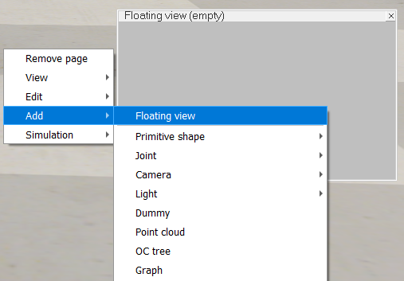
Vision Sensor Feedback
To see what is seen by each vision sensor, we need to add Floating view
On any empty space in the simulation window, Right click > Add > Floating view

Slide 3
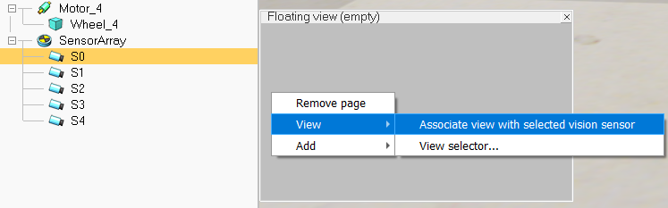
Vision Sensor Feedback
To see what is seen by each vision sensor, we need to add Floating view
On any empty space in the simulation window, Right click > Add > Floating view
Drag and resize the window as necessary
Select a vision sensor from Scene hierarchy
On the created floating view > Right Click > View > Associate view with selected vision sensor
Vision sensor output should be visible if the simulation is started

Slide 4
Line Following Robot - Lua
Scripts are responsible for controlling inside the simulation
To create a script for any object (robot/joint/dummy shape) we simply select object > right click > Add > Associated child script > Non-threaded > Lua
We will convert a demo Lua script from the CoppeliaSim documentation to create a code for our own robot: https://www.coppeliarobotics.com/helpFiles/en/lineFollowingBubbleRobTutorial.htm

Slide 5
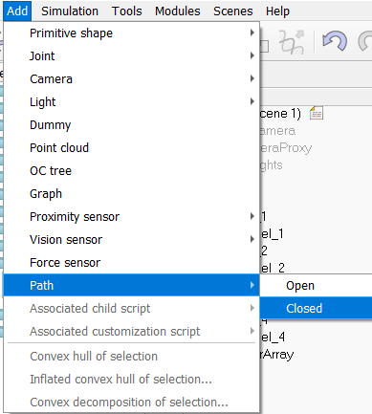
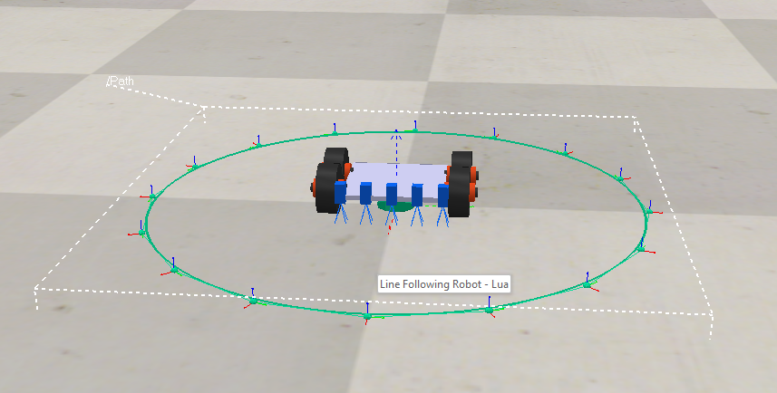
Creating a Line for Following
To create a line following path, Add > Path > Closed
A circular path will be created

Slide 6
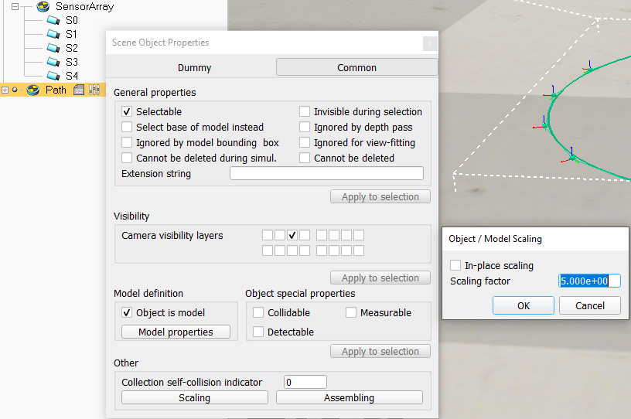
Creating a Line for Following
To increase the path size, on the path dummy icon, double click > Scene Object Properties > Common > Scaling > Scaling factor = 5
This will scale the path size by a factor of 5
To move around the path control points, simply select them from the Scene Hierarchy and then use the translate tool to create paths of any arbitrary shape

Slide 7
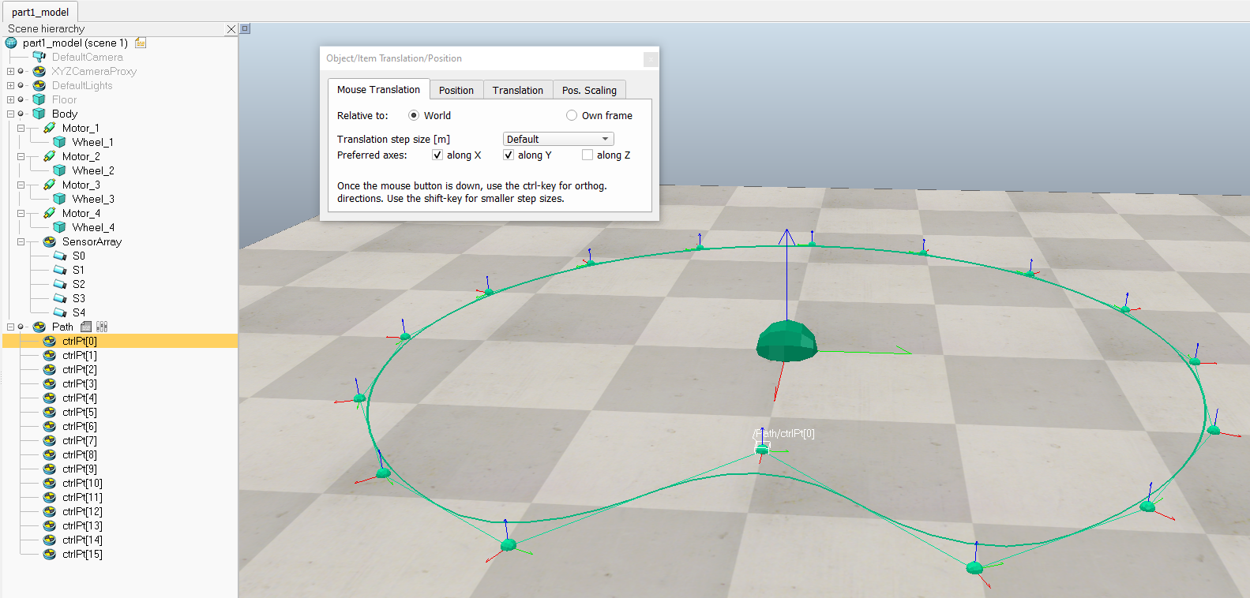
Creating a Line for Following
Path shaping

Slide 8
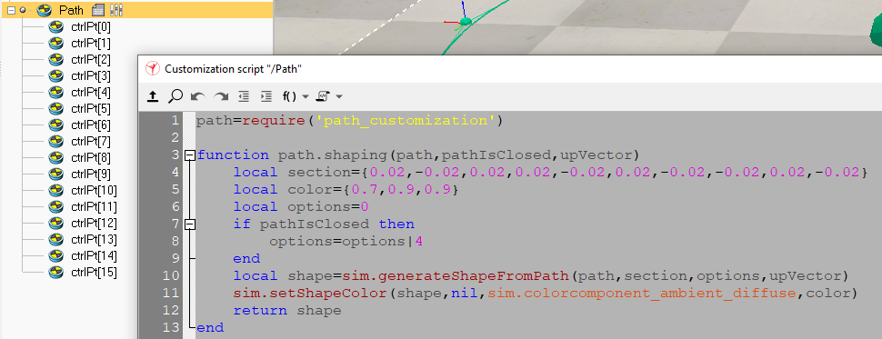
Creating a Line for Following
Now we need to give visual properties to the path. On the script icon aside the path object, double click to open script
section indicates the render properties of the path. According to the documentation, replace the line with:
local section={-0.02,0.001,0.02,0.001}
color indicates path color in RGB format. We can change it to {0.2, 0.2, 0.2} for a dark gray color
After modifying script, click on the Restart Script icon on the top left of the script editor for changes to take effect

Slide 9
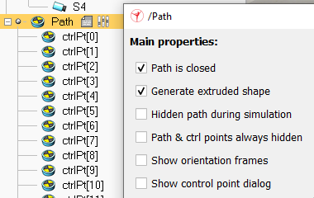
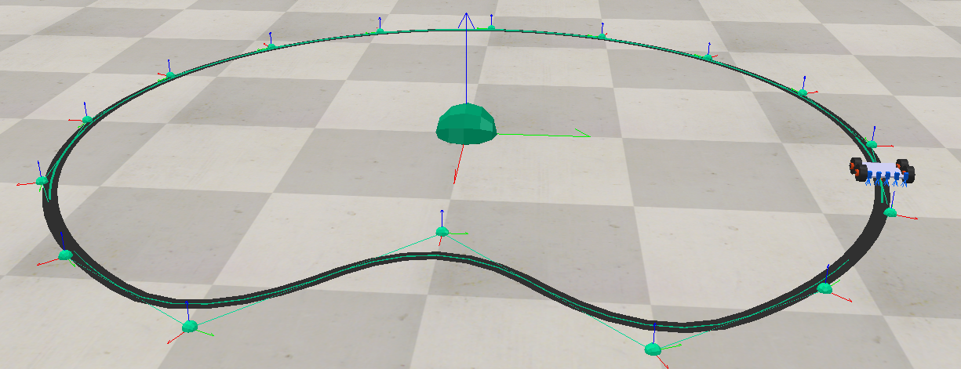
Creating a Line for Following
Double click on the parameters icon > Check Generate extruded shape
The path will take our desired black color. Drag the robot to any place on the path

Slide 10
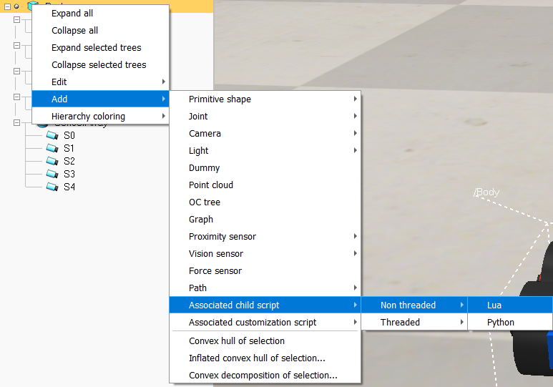
Robot Code - Lua
To create a script for our robot, select object > right click > Add > Associated child script > Non-threaded > Lua
We will copy and paste the example LFR script from the last part of the documentation page and modify it for our robot: https://www.coppeliarobotics.com/helpFiles/en/lineFollowingBubbleRobTutorial.htm
The following slides are based on the provided part2_LFR_LUA.ttt file

Slide 11
Code Structure
General system flow for any robot
Initialization
An empty non-threaded script has the following parts:
function sysCall_init()
Does all the initialization for the associated object
Runs once after starting simulation
function sysCall_sensing()
Called during each loop to collect sensor data
function sysCall_actuation()
Called during each loop after sensor data is received
Sends commands to the actuators for moving the robot
function sysCall_cleanup()
Called after end of simulation
Any custom function can be added for ease of coding
Sensing
Actuation
Termination

Slide 12
Object Handles
During sysCall_init(), we need to find the references for motors and sensors.
In real hardware, we initialize the microcontroller pins in this stage.
In simulation, we fetch the object handles
For our simulation, we first find the 4 motors by their exact name in the scene hierarchy (duplicate names are not allowed in simulation)
leftMotor1=sim.getObject("./Motor_FL")
leftMotor2=sim.getObject("./Motor_BL")
rightMotor1=sim.getObject("./Motor_FR")
rightMotor2=sim.getObject("./Motor_BR")
leftMotor1
rightMotor1
leftMotor2
rightMotor2
Robot structure

Slide 13
Object Handles
We find the 5 vision sensors, and save the handles to an array for easy access
line_sensor_handle={-1,-1,-1,-1,-1}
line_sensor_handle[1]=sim.getObject("./Vis[4]")
line_sensor_handle[2]=sim.getObject("./Vis[3]")
line_sensor_handle[3]=sim.getObject("./Vis[2]")
line_sensor_handle[4]=sim.getObject("./Vis[1]")
line_sensor_handle[5]=sim.getObject("./Vis[0]")
leftMotor1
rightMotor1
leftMotor2
rightMotor2
Robot structure

Slide 14
Reading Sensor Data
After initialization, the code enters a loop of reading sensors and acting based on the readings
In a smaller loop, the code takes the reading of each sensor one by one by the following function: result,data=sim.readVisionSensor(line_sensor_handle[i])
‘result’ tells us whether the sensor was properly read
‘data’ contains the actual reading
‘data’ is a list of values, data[11] contains the average pixel value, so we use that information for detecting lines
data[11] is thresholded by comparing to 0.5 sensorReading[i]=(data[11]<0.5)
If data[11] < 0.5; sensor is on black line
If data[11] > 0.5; sensor is not on black line

Slide 15
Adjusting Motor Velocities
Line is on left of robot
Line is on right of robot
leftMotor1
rightMotor1
leftMotor1
rightMotor1
leftMotor2
rightMotor2
leftMotor2
rightMotor2
Left motors speed decrease
Right motors speed increase
Left motors speed increase
Right motors speed decrease

Slide 16
Adjusting Motor Velocities
The sensor readings give us an idea of where the line is relative to the robot
If the right-most sensor is on line, then the robot is on the left, and we need to go right
Increase speed of left motors
if sensorReading[1] then
leftV=0.03*speed
end
If the left-most sensor is on line, then the robot is on the right, and we need to go left
Increase speed of right motors
if sensorReading[5] then
rightV=0.03*speed
end
Finally send target velocity information to the motors:
sim.setJointTargetVelocity(leftMotor1,leftV)
sim.setJointTargetVelocity(leftMotor2,leftV)
sim.setJointTargetVelocity(rightMotor1,rightV)
sim.setJointTargetVelocity(rightMotor2,rightV)

Slide 17
Running the Simulation

